Slide 1
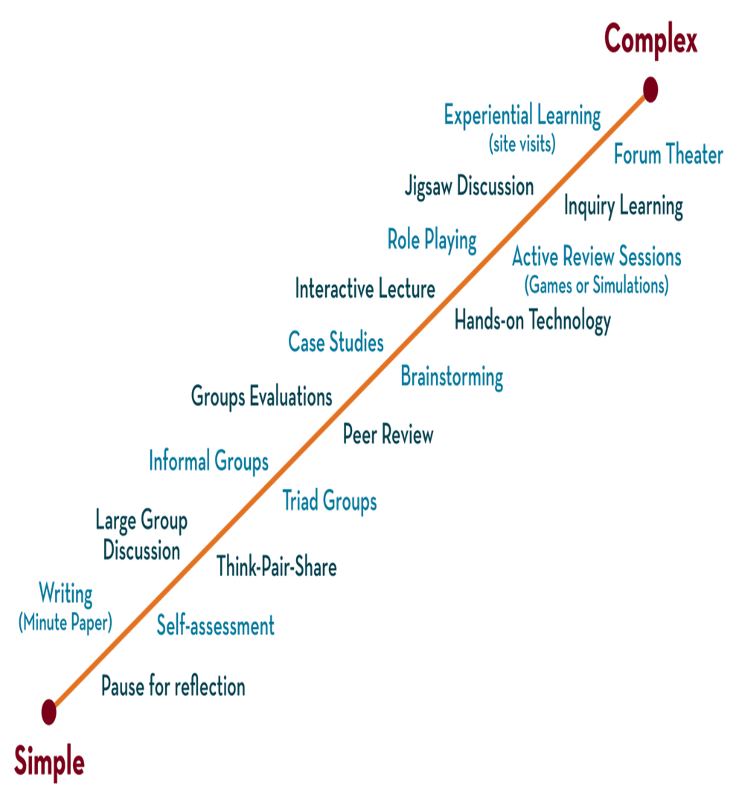

Department of CSE
DESIGN AND ANALYSIS OF ALGORITHMS
24CS2203
Topic:
Single Source Shortest Path
Greedy Method

Slide 2
Shortest Path Problem
Shortest path problem is a problem of finding the shortest path(s) between vertices of a given graph.
Shortest path between two vertices is a path that has the least cost as compared to all other existing paths.
Applications-
Google Maps
Road Networks
Logistics Research

Slide 3
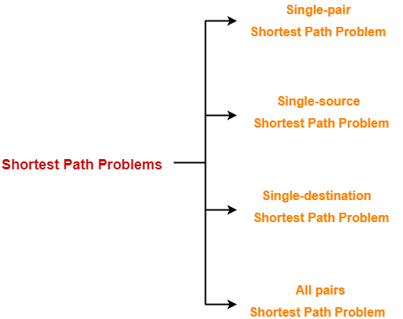
Types of Shortest Path

Slide 4
Shortest Path
It is a shortest path problem where the shortest path from a given source vertex to all other remaining vertices is computed.
Dijkstra’s Algorithm and Bellman-Ford Algorithm are famous algorithms for solving single-source shortest path problems.

Slide 5
Dijkstra Algorithm
Dijkstra Algorithm is a very famous greedy algorithm.
It is used for solving the single source shortest path problem.
It computes the shortest path from one particular source node to all other remaining nodes of the graph.
Dijkstra algorithm works only for connected graphs.
Dijkstra algorithm works only for those graphs that do not contain any negative weight edge.
The actual Dijkstra algorithm does not output the shortest paths. It only provides the value or cost of the shortest paths.
Dijkstra algorithm works for directed as well as undirected graphs.

Slide 6
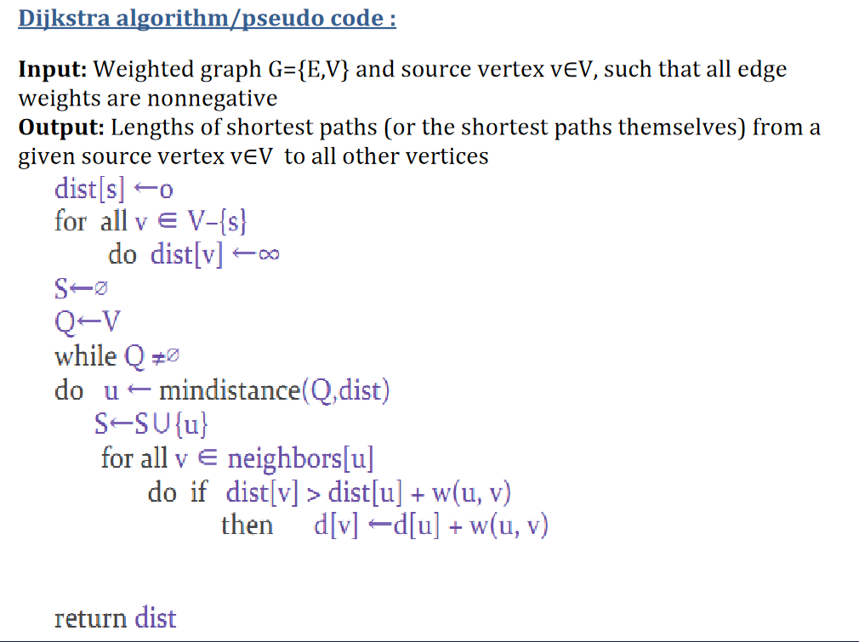

Slide 7
Implementation
Step-01:
In the first step. two sets are defined-
One set contains all those vertices included in the shortest path tree.
In the beginning, this set is empty.
Another set contains all those vertices left to be included in the shortest path tree.
In the beginning, this set contains all the vertices of the given graph.

Slide 8
Step-02:
For each vertex of the given graph, two variables are defined as
Π[v] which denotes the predecessor of vertex ‘v’
d[v] which denotes the shortest path estimate of vertex ‘v’ from the source vertex.
Initially, the value of these variables is set as
The value of variable ‘Π’ for each vertex is set to NIL i.e. Π[v] = NIL
The value of variable ‘d’ for source vertex is set to 0 i.e. d[S] = 0
The value of variable ‘d’ for remaining vertices is set to ∞ i.e. d[v] = ∞

Slide 9
Step-03:
The following procedure is repeated until all the vertices of the graph are processed-
Among unprocessed vertices, a vertex with a minimum value of variable ‘d’ is chosen.
Its outgoing edges are relaxed.
After relaxing the edges for that vertex, the sets created in step-01 are updated.

Slide 10
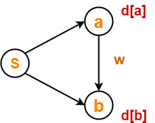
Edge relaxation
Consider the edge (a,b) in the following graph-
Here, d[a] and d[b] denotes the shortest path estimate for vertices a and b respectively from the source vertex ‘S’.
Now, If d[a] + w < d[b]
then d[b] = d[a] + w and Π[b] = a
This is called as edge relaxation.

Slide 11
Time complexity
The given graph G is represented as an adjacency matrix.
Priority queue Q is represented as an unordered list.
Here,
A[i,j] stores the information about edge (i,j).
Time taken for selecting i with the smallest dist is O(V).
For each neighbor of i, time taken for updating dist[j] is O(1) and there will be maximum V neighbors.
Time taken for each iteration of the loop is O(V) and one vertex is deleted from Q.
Thus, total time complexity becomes O(V²).

Slide 12
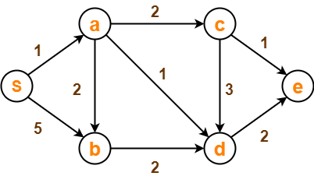
Example
Using Dijkstra’s Algorithm, find the shortest distance from source vertex ‘S’ to remaining vertices in the following graph-

Slide 14
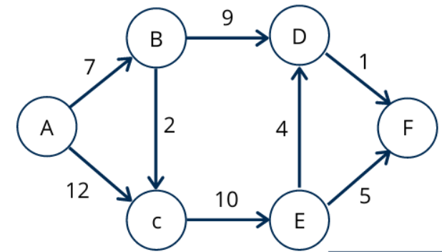

Slide 15
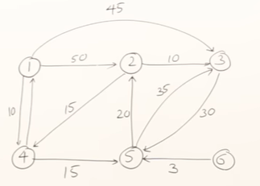
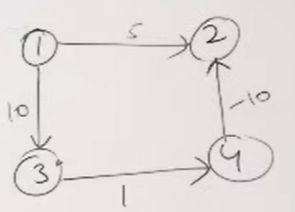

Slide 16
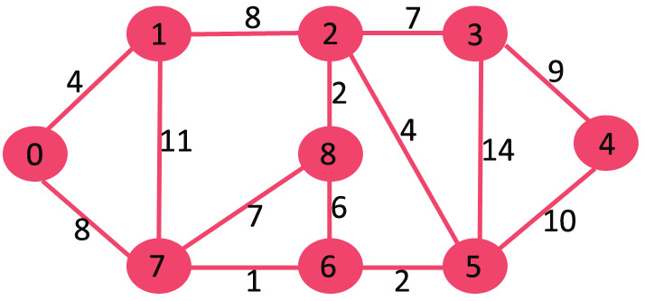

Slide 17
Solution
Step-01:
The following two sets are created
Unvisited set : {S , a , b , c , d , e}
Visited set : { }
Step-02:
The two variables Π and d are created for each vertex and initialized as
Π[S] = Π[a] = Π[b] = Π[c] = Π[d] = Π[e] = NIL
d[S] = 0
d[a] = d[b] = d[c] = d[d] = d[e] = ∞

Slide 18
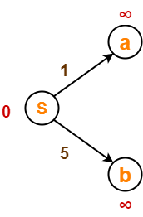
Step-03:
Vertex ‘S’ is chosen.
This is because shortest path estimate for vertex ‘S’ is least.
The outgoing edges of vertex ‘S’ are relaxed.
Before Edge Relaxation
Now,
d[S] + 1 = 0 + 1 = 1 < ∞
∴ d[a] = 1 and Π[a] = S
d[S] + 5 = 0 + 5 = 5 < ∞
∴ d[b] = 5 and Π[b] = S

Slide 19
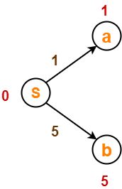
After edge relaxation, our shortest path tree is
Now, the sets are updated as
Unvisited set : {a , b , c , d , e}
Visited set : {S}

Slide 20
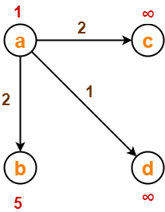
Step-04:
Vertex ‘a’ is chosen.
This is because the shortest path estimate for vertex ‘a’ is the least.
The outgoing edges of vertex ‘a’ are relaxed.
Before Edge Relaxation

Slide 21
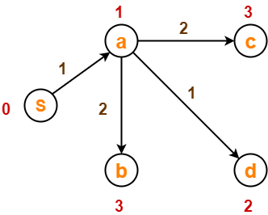
d[a] + 2 = 1 + 2 = 3 < ∞ ∴ d[c] = 3 and Π[c] = a
d[a] + 1 = 1 + 1 = 2 < ∞ ∴ d[d] = 2 and Π[d] = a
d[b] + 2 = 1 + 2 = 3 < 5 ∴ d[b] = 3 and Π[b] = a
After edge relaxation, our shortest path tree is-
Now, the sets are updated as-
Unvisited set : {b , c , d , e}
Visited set : {S , a}

Slide 22
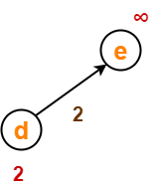
Step-05:
Vertex ‘d’ is chosen.
This is because shortest path estimate for vertex ‘d’ is least.
The outgoing edges of vertex ‘d’ are relaxed.
Before Edge Relaxation
Now,
d[d] + 2 = 2 + 2 = 4 < ∞
∴ d[e] = 4 and Π[e] = d

Slide 23
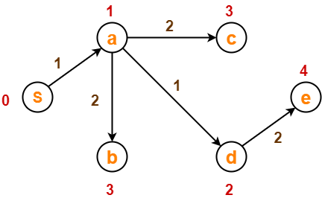
After edge relaxation, our shortest path tree is-
Now, the sets are updated as-
Unvisited set : {b , c , e}
Visited set : {S , a , d}

Slide 24

Step-06:
Vertex ‘b’ is chosen.
This is because shortest path estimate for vertex ‘b’ is least.
Vertex ‘c’ may also be chosen since for both the vertices, shortest path estimate is least.
The outgoing edges of vertex ‘b’ are relaxed.
Before Edge Relaxation-
Now, d[b] + 2 = 3 + 2 = 5 > 2
∴ No change

Slide 25
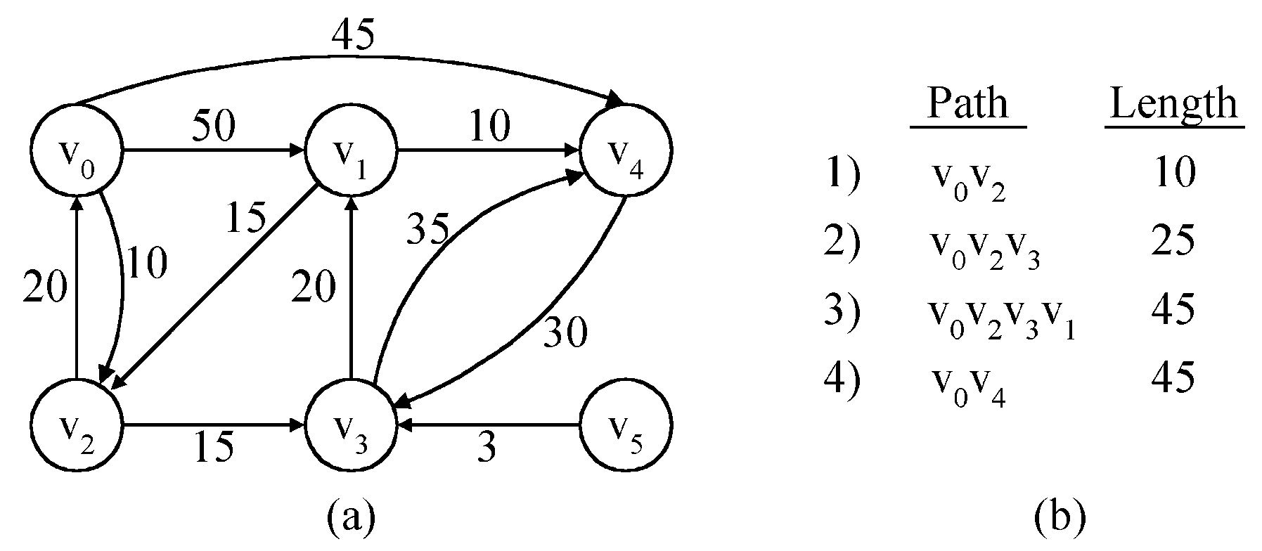
Single Source Shortest Path
Given a positively weighted directed graph G with a source vertex ₁, find the shortest paths from V1 to all other vertices in the graph.
v
V₁
V₂
V₅
V₁V₃
V₁V₃V₄
V₁V₃V₄V₂
V₃
V₄
V₆
V₁V₅
5) V₁V₃V₄V₆ 28

Slide 26
After edge relaxation, our shortest path tree remains the same as in
Step-05.
Now, the sets are updated as-
Unvisited set : {c , e}
Visited set : {S , a , d , b}

Slide 27
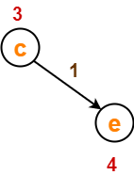
Step-07:
Vertex ‘c’ is chosen.
This is because shortest path estimate for vertex ‘c’ is least.
The outgoing edges of vertex ‘c’ are relaxed.
Before Edge Relaxation-
Now,
d[c] + 1 = 3 + 1 = 4 = 4
∴ No change

Slide 28
SSSP Dijkstra’s algorithm
Dijkstra’s algorithm assumes that cost(e)≥0 for each e in the graph.
Maintains a set S of vertices whose SP from v ( source) has been determined.
a) Select the next minimum distance node u, which is not in S.
b) for each node w adjacent to u do
  if( dist[w]>dist[u]+cost[u,w]) ) then
dist[w]:=dist[u]+cost[u,w];
Repeat step (a) and (b) until S=n (number of vertices).

Slide 29
After edge relaxation, our shortest path tree remains the same as in Step-05.
Now, the sets are updated as-
Unvisited set : {e}
Visited set : {S , a , d , b , c}
Step-08:
Vertex ‘e’ is chosen.
This is because shortest path estimate for vertex ‘e’ is least.
The outgoing edges of vertex ‘e’ are relaxed.
There are no outgoing edges for vertex ‘e’.
So, our shortest path tree remains the same as in Step-05.

Slide 30
Now, the sets are updated as-
Unvisited set : { }
Visited set : {S , a , d , b , c , e}

Slide 31
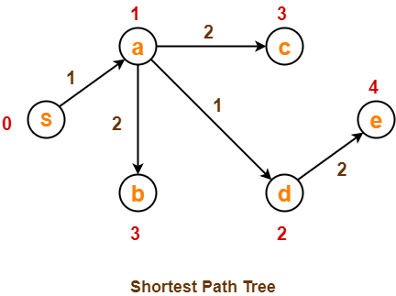
Now,
All vertices of the graph are processed.
Our final shortest path tree is as shown below.
It represents the shortest path from source vertex ‘S’ to all other remaining vertices.
The order in which all the vertices are processed is : S , a , d , b , c , e.

